Slide 1
Smart Water Quality Monitoring
Ahmad Mansour – b0088651
Baraa Abed – b0088000

Slide 2
01
Smart Water Monitoring System for Real-time water quality and usage monitoring
M. Kumar Jha, R. Kumari Sah, M. S. Rashmitha, R. Sinha, B. Sujatha and K. V. Suma, 2018 International Conference on Inventive Research in Computing Applications (ICIRCA), Coimbatore, India, 2018, pp. 617-621

Slide 3
Features - Smart water quality meter
System to monitor quality of water received at household
Measures pH, temperature, and turbidity
Calculates conductivity through relationship with temperature
Water quality information available on web portal
Sends SMS and email alerts to user and authority when water quality is unsuitable.

Slide 4
Features - Smart water quantity meter
System to monitor water consumption in a household
Relies on water flow sensor to measure water usage
Proposes the use of a three-slab billing system based on liters consumed
Water consumption levels and billing information available on web portal
SMS and email alerts to user when consumption crosses a limit

Slide 5
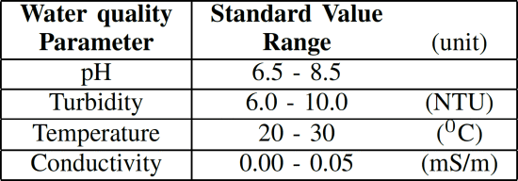
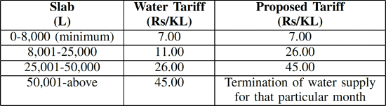
[1] - https://ieeexplore.ieee.org/document/8597179

Slide 6
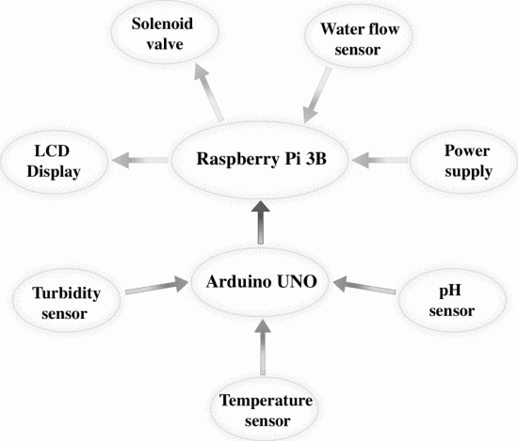
Hardware diagram
Turbidity, temperature, and pH sensors: For water quality measurements
Arduino Uno: Collects sensor readings rather than ADC module. USB serial communication with RPi
Water flow sensor: For water consumption measurements
Solenoid valve: To control water supply
LCD display: Used in testing
RPi Model 3B: Runs water quality/quantity calculations and sends data to web portal
[1] - https://ieeexplore.ieee.org/document/8597179

Slide 7
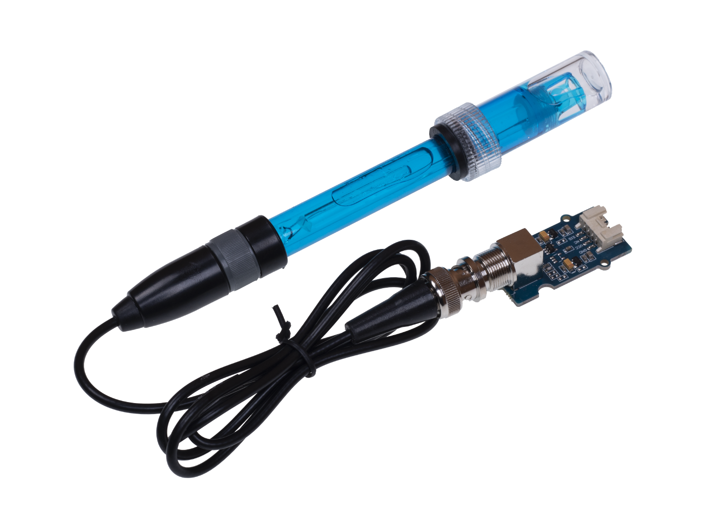
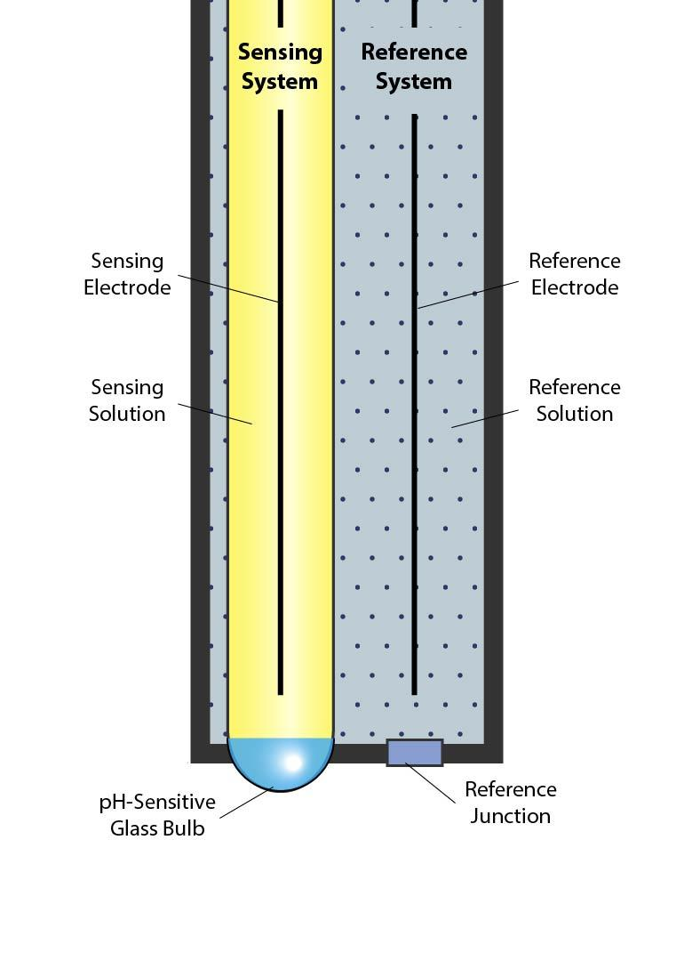
Sensors – SEN0161 pH sensor
Measures pH by comparing the voltage of the glass electrode and reference electrode
Glass electrode experiences potential difference when interacting with hydrogen ions
Connected to module which converts reading to analog
3.3V/5.0V operation
0 - 14 pH operation range
±0.15 pH resolution
0 - 60 ºC operating temperature
<1 minute response time
Notes:
pH sensor photo: Grove - PH Sensor Kit (E-201C-Blue) | Seeed Studio Wiki
pH sensor explanation photo: The Basics Of A pH Sensor - ICON Process Controls (iconprocon.com)

Slide 8
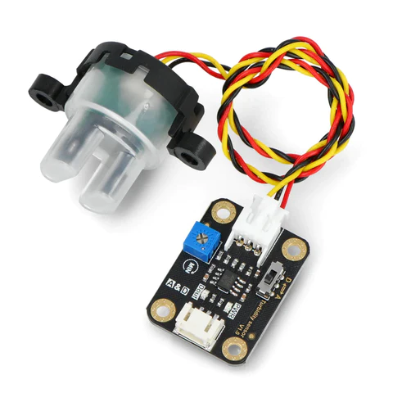
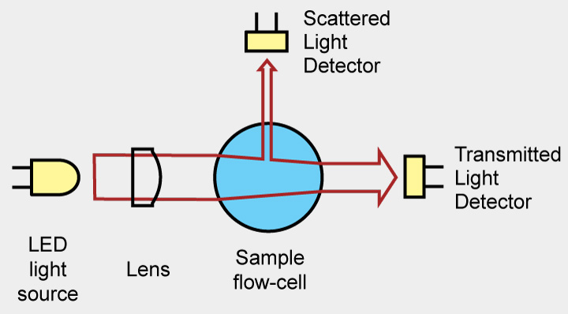
Sensors – SEN0189 turbidiy sensor
Measures the clarity of the water
Emits a light and measures the scattered light in the water
Connected to module which converts reading to analog
5.0V operation
0 - 1000 Nephelometric Turbidity unit (NTU) operation range
±30 NTU resolution
-20 - 90 ºC operating temperature
<500 ms response time
Notes:
Turbidity sensor photo: Arduino Uno - SMD Botland - Robotic Shop
Turbidity sensor explanation photo: Turbidity of Colloidal dispersion is... - Solution Pharmacy | Facebook

Slide 9
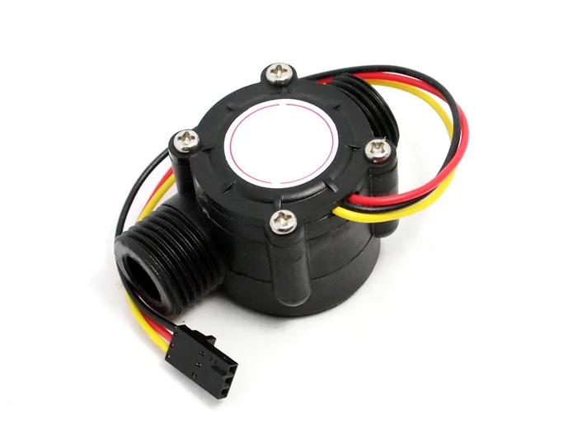
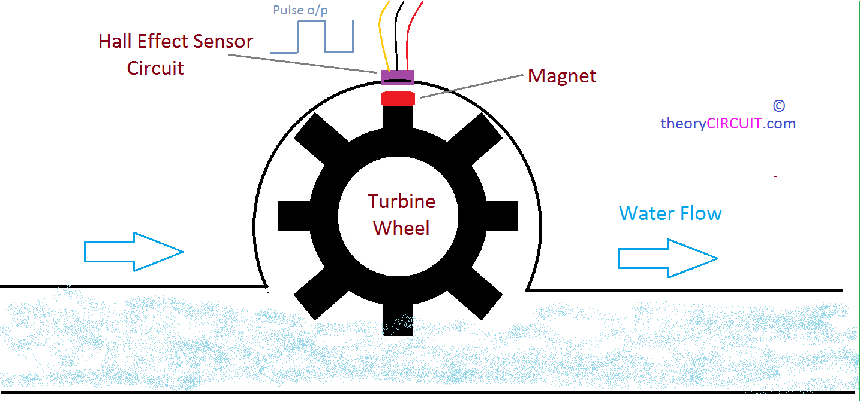
Sensors – Analog water flow sensor
Measures the flow rate of the water
Internal turbine spins according to water flow
Hall-effect sensor detects magnet and translate rotations to PWM signal
5.0 - 18.0V operation
0 - 30 L/min operation range
-25 - 80 ºC operating temperature
<500 ms response time
Notes:
Water flow sensor photo: How to Use Water Flow Sensor - Arduino Tutorial : 5 Steps (with Pictures) – Instructables
Water flow sensor explanation photo: Measure Water Flow Rate and Volume Using Arduino : 5 Steps - Instructables

Slide 10

Other sensors
DFR0198 temperature sensor
Explained in paper 2

Slide 11


Controllers
Raspberry Pi model 3B
Arduino Uno
Explained in paper 2

Slide 12
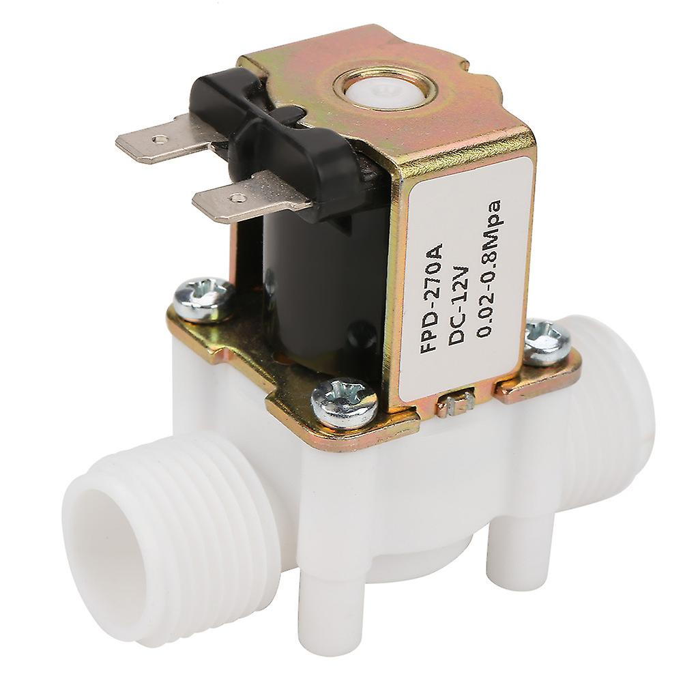
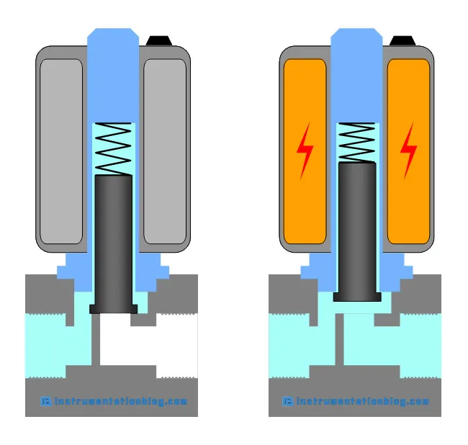
Actuators – Solenoid valve
Controls the movement of water (and other fluids) through the pipe
Internal plunger does not allow water to pass
When powered, electromagnet attracts plunger and lets water through
12V operation (requires relay switch)
Notes:
Solenoid valve photo: images (1001×1001) (gstatic.com)
Solenoid valve explanation photo: How does a Solenoid Valve work? (instrumentationblog.com)

Slide 13
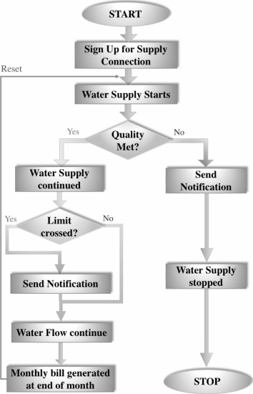
Software flowchart
Starts with user signing up for service and setup
Solenoid valve is open to start water supply
Checks if water quality is suitable:
If unsuitable, sends SMS/email to user & authority and close solenoid valve
If suitable, continues water supply
Checks if any water consumption limit is crossed
If crossed, sends SMS/email to user
At the end of the month, water bill is generated
[1] - https://ieeexplore.ieee.org/document/8597179

Slide 14
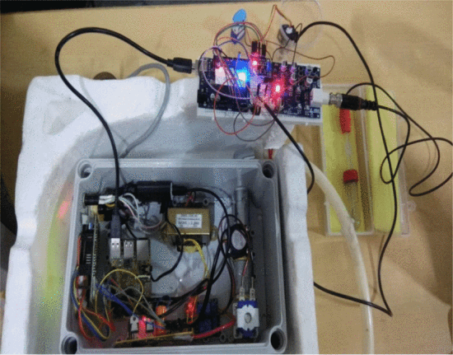
System photo
[1] - https://ieeexplore.ieee.org/document/8597179

Slide 15
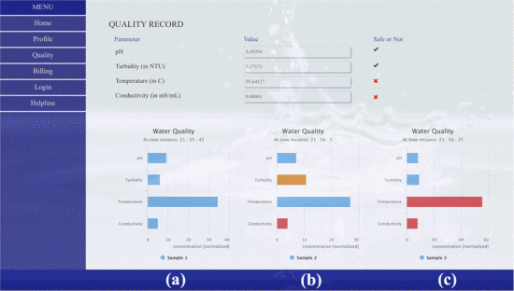
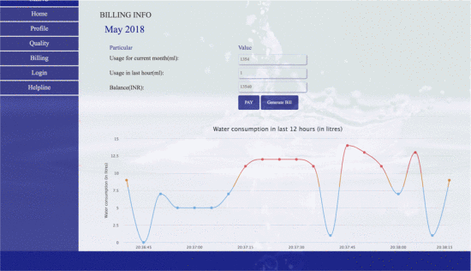
Web portal
[1] - https://ieeexplore.ieee.org/document/8597179

Slide 16
02
IoT based Smart Water Quality Monitoring System
M. Mukta, S. Islam, S. D. Barman, A. W. Reza and M. S. Hossain Khan, 2019 IEEE 4th International Conference on Computer and Communication Systems (ICCCS), Singapore, 2019, pp. 669-673

Slide 17
Features – Water quality parameters collection
System to quantify quality of water samples
Measures pH, temperature, conductivity, and turbidity
Measured physical parameters sent to desktop application through USB serial communication

Slide 18
Features – Desktop application
System to read, analyze, and view data sent on serial port
Uses machine learning (ML) predictions and World Health Organization (WHO) standards
ML predictions based fast forest binary classifier algorithm
Classifies water sample as “Drinkable” or “Not Drinkable”

Slide 19
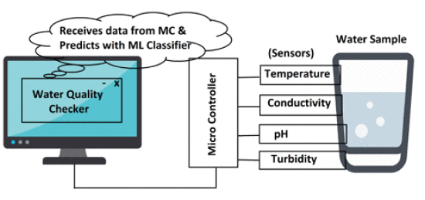
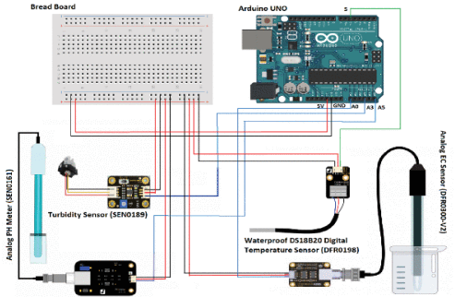
Hardware diagram
Turbidity, temperature, conductivity, and pH sensors: For water quality measurements
Arduino Uno: Collects sensor readings and sends them to desktop app through USB serial communication
Desktop app: Used to store received data and analyze it
[2] - https://ieeexplore.ieee.org/document/8821742

Slide 20
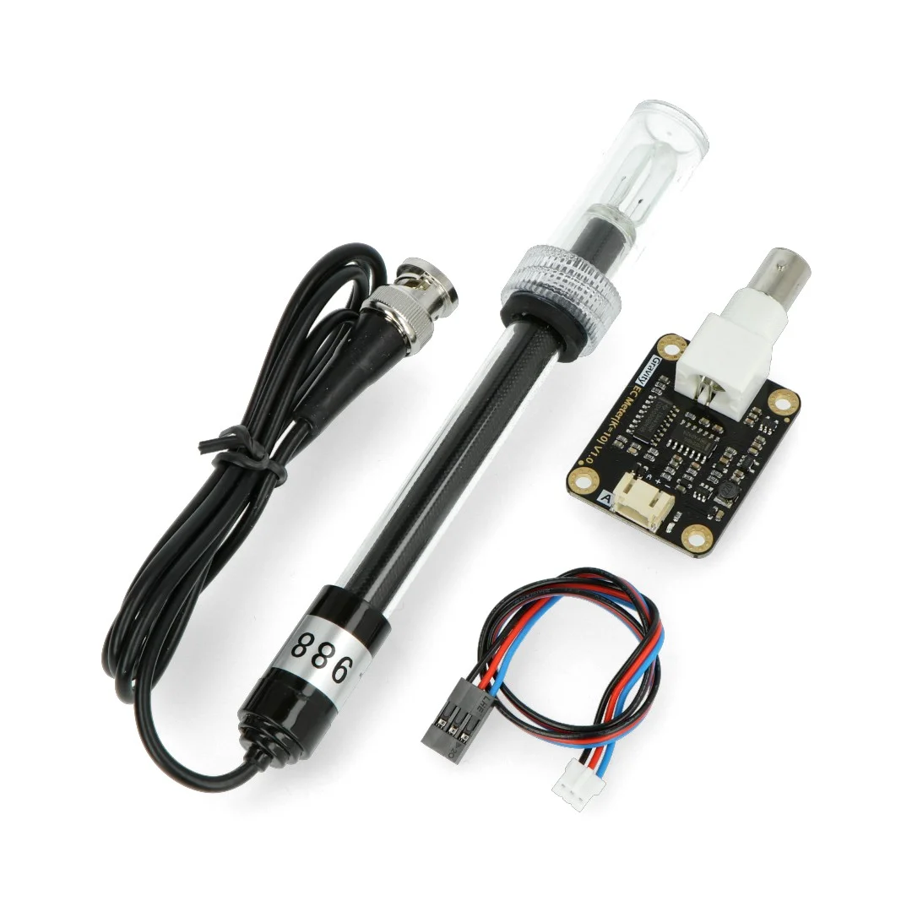
Sensors – DFR0300 conductivity sensor
Measures the conductivity by measuring electrical current in water
AC voltage applied across two electrodes to generate current (not DC to prevent electrolysis)
Connected to module which converts reading to analog
3.3V/5.0V operation
0 - 20 ms/cm operation range
±5% full scale (±1 ms/cm) resolution
0 - 40 ºC operating temperature
Notes:
Conductivity sensor photo: Gravity - Analog Electrical Conductivity Sensor - Botland - Robotic Shop

Slide 21
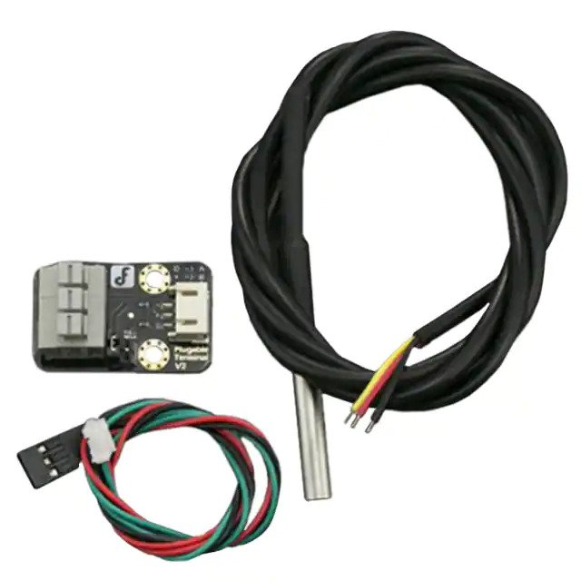
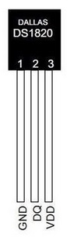
Sensors – DFR0198 temperature sensor
Waterproof version of the DS1820. Water Measures the temperature of the water
Probe has circuit to check voltage across diode terminals which varies as temperature changes
Connected to module which converts analog reading to 9 to 12-bit digital (configurable)
3.3V/5.0V operation
-10 - 85 ºC operation range
±0.5 ºC resolution
-55 - 125 ºC operating temperature
<750 ms response time
Notes:
DFR0198 Temperature sensor photo: Waterproof DS18B20 Sensor Kit - ADI & DFRobot | DigiKey
DS1820 temperature sensor photo: DS18S20+ Analog Devices - Datasheet PDF & Technical Specs (allaboutcircuits.com)

Slide 22


Other sensors
SEN0161 pH sensor
SEN0189 turbidity sensor
Explained in paper 1
Explained in paper 1

Slide 23

Controllers – Arduino Uno Rev3
Microcontroller board from Arduino
Based on ATmega328P chip
5.0V, 8-bit RISC-based chip
Operates at 16 MHz clock speed
2 KB SRAM + 1 KB EEPROM
32 KB flash memory
14 digital I/O pins capable of:
6 PWM outputs
1 I2C, 1 SPI, and 1 UART
6 analog inputs
USB-B port for serial communication + power
Barrel jack for external power
Notes:
Arduino uno rev3 photo: Arduino Uno Rev3 — Arduino Online Shop

Slide 24
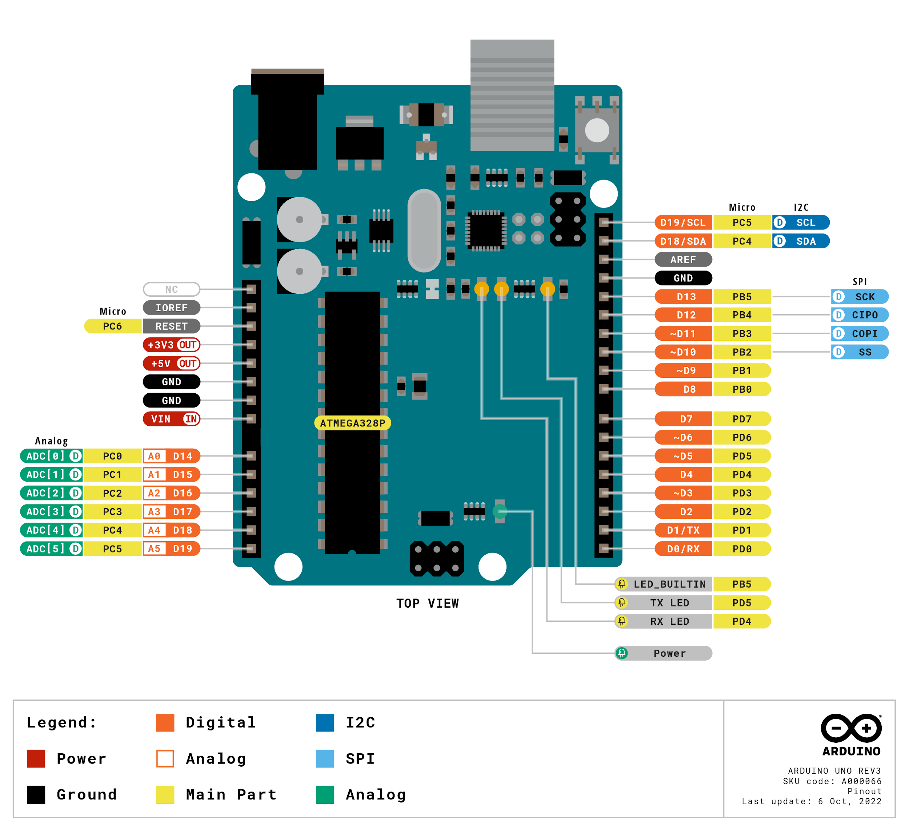
Notes:
Arduino uno rev3 pinout: UNO R3 | Arduino Documentation

Slide 25
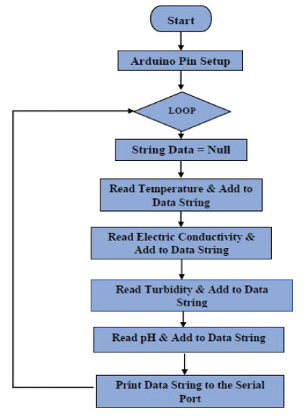
Software flowchart - Arduino
Starts with setting up digital & analog input pins
Keeps reading temperature, conductivity, turbidity, and pH, concatenating it to temp string, and sending readings on serial port
[2] - https://ieeexplore.ieee.org/document/8821742

Slide 26
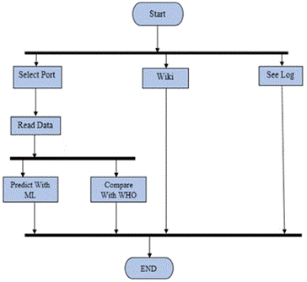
Software flowchart – Desktop app
Starts with user choosing either to read data, check wiki, or see data log
To read data, user selects serial port Arduino connected to and clicks read data
If ML Prediction clicked, passed data into ML model for prediction
If WHO Standard clicked, compared with WHO defined threshold
To see logged data, user clicks Output Log
[2] - https://ieeexplore.ieee.org/document/8821742

Slide 27
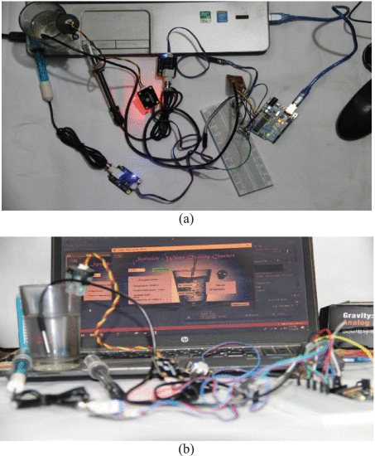
System photo
[2] - https://ieeexplore.ieee.org/document/8821742

Slide 28
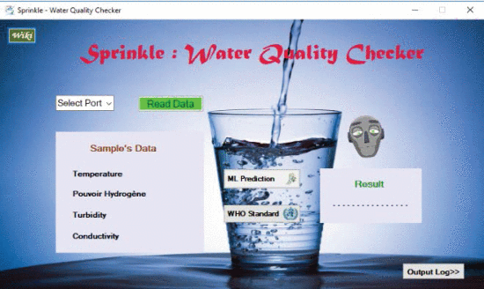
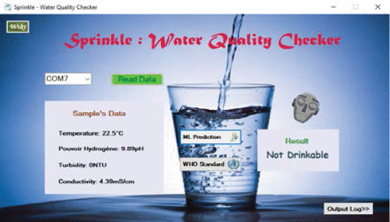
Desktop application
[2] - https://ieeexplore.ieee.org/document/8821742

Slide 29
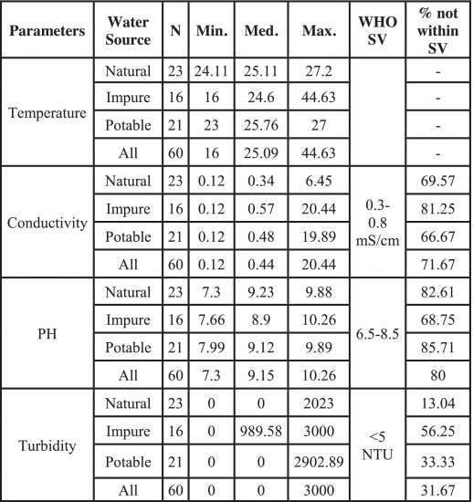
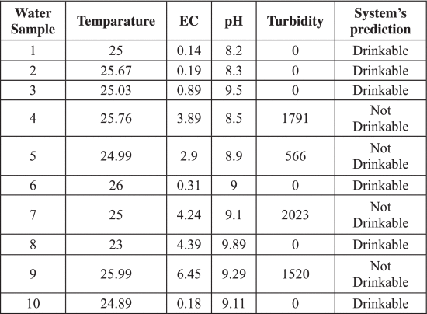
Results
[2] - https://ieeexplore.ieee.org/document/8821742

Slide 30
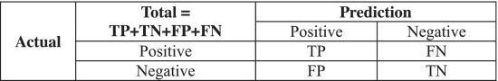
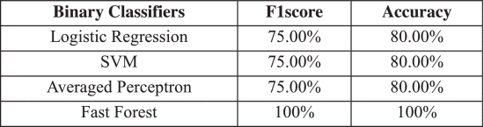
Results
Accuracy = (TP+TN)/Total
Precision (PR) = TP/(TP+TN)
Recall (RE) = TP/(TP+FN)
F1score = 2×[(PR×RE)/(PR+ RE)]
[2] - https://ieeexplore.ieee.org/document/8821742

Slide 31
Findings & Conclusion
Smart Water Quality Monitoring system important to make sure water quality suitable for use
System can be used to determine if water drinkable, potable, etc.
Use of microcontroller + simple sensors allows for cheap and effective water quality monitoring system
The parameters used to measure quality in both papers are pH, Temperature, Turbidity, and Conductivity
The first paper suggests including ML in future work, while the second uses ML in their paper
Future work can concentrate on integrating fuzzy logic, predictive maintenance, and more parameters

Slide 32
Thanks
Questions?
Please keep this slide for attribution

Slide 33
References
[1] M. Kumar Jha, R. Kumari Sah, M. S. Rashmitha, R. Sinha, B. Sujatha and K. V. Suma, "Smart Water Monitoring System for Real-Time Water Quality and Usage Monitoring," 2018 International Conference on Inventive Research in Computing Applications (ICIRCA), Coimbatore, India, 2018, pp. 617-621, doi: 10.1109/ICIRCA.2018.8597179.
[2] M. Mukta, S. Islam, S. D. Barman, A. W. Reza and M. S. Hossain Khan, "Iot based Smart Water Quality Monitoring System," 2019 IEEE 4th International Conference on Computer and Communication Systems (ICCCS), Singapore, 2019, pp. 669-673, doi: 10.1109/CCOMS.2019.8821742.
(All external photo references in notes of respective slide)

